Slide 2
LabVIEW for FRC: Advanced
Introduction to Command and Control
April Riddett
Applications Engineer

Slide 3
Agenda
Command and Control
Overview
Architecture: Project Explorer
Implementation
Creating New Commands
Creating New Subsystems
Questions?
Notes:
dafafdfas

Slide 4
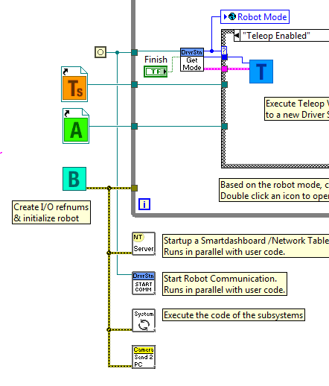
What is Command and Control?
FRC robots are generally built of independent mechanisms
Drive
Shooter
Arm
Subsystems make up the full robot
Subsystems have an independent controller loop
Notes:
Command and Control recognizes that FRC robots tend to be built up of relatively independent mechanisms such as Drive, Shooter, Arm, etc. Each of these is referred to as a subsystem and needs code that will coordinate the various sensors and actuators of the subsystem in order to complete requested commands, or actions, such as “Close Gripper” or “Lower Arm”. One of the key principles of this framework is that subsystems will each have an independent controller loop that is solely responsible for updating motors and other actuators.

Slide 5

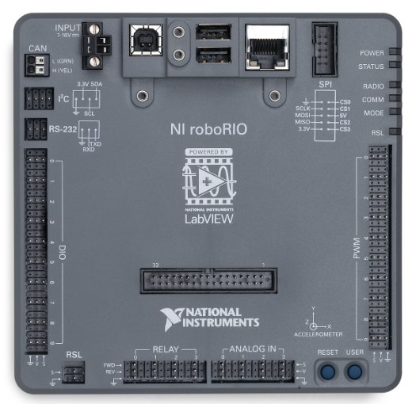
What is Command and Control?
Code outside of the subsystem controller can issue commands which may change the robot’s output, but should not directly change any outputs.
Auto = 1
Auto = 1
Notes:
Code outside of the subsystem controller can issue commands which may change the robot’s output, but should not directly change any outputs. The difference is very subtle but this means that outputs can only possibly be updated from one location in the project. This speeds up debugging a robot behaving unexpectedly by giving you the ability to look through a list of commands sent to the subsystem rather than searching your project for where an output may have been modified. It also becomes easier to add an additional sensor, change gearing, or disable a mechanism without needing to modify code outside of the controller.
Game code, primarily consisting of Autonomous and TeleOp, will typically need to update set points and react to the state of certain mechanisms. For Autonomous, it is very common to define the robot’s operation as a sequence of operations – drive here, pick that up, carry it there, shoot it, etc. Commands can be wired sequentially with additional logic to quickly build complex routines. For teleOp, the same commands can execute asynchronously, allowing the robot to always process the latest driver inputs, and if implemented properly, new commands will interrupt, allowing the drive team to quickly respond to field conditions while also taking advantage of automated commands and command sequences.

Slide 6

What is Command and Control?
Code outside of the subsystem controller can issue commands which may change the robot’s output, but should not directly change any outputs.
Auto = 1
Auto = 1
E-stop = 1
E-stop = 1
Notes:
Code outside of the subsystem controller can issue commands which may change the robot’s output, but should not directly change any outputs. The difference is very subtle but this means that outputs can only possibly be updated from one location in the project. This speeds up debugging a robot behaving unexpectedly by giving you the ability to look through a list of commands sent to the subsystem rather than searching your project for where an output may have been modified. It also becomes easier to add an additional sensor, change gearing, or disable a mechanism without needing to modify code outside of the controller.
Game code, primarily consisting of Autonomous and TeleOp, will typically need to update set points and react to the state of certain mechanisms. For Autonomous, it is very common to define the robot’s operation as a sequence of operations – drive here, pick that up, carry it there, shoot it, etc. Commands can be wired sequentially with additional logic to quickly build complex routines. For teleOp, the same commands can execute asynchronously, allowing the robot to always process the latest driver inputs, and if implemented properly, new commands will interrupt, allowing the drive team to quickly respond to field conditions while also taking advantage of automated commands and command sequences.

Slide 7
Why should I use C&C?
Allows code to scale better
Abstracts details of the implementation
Game code is built from sequences of high-level command VIs
I/O encapsulation
Notes:
Command and Control adds functionality to the existing LabVIEW project templates, allowing code to scale better with more sophisticated robots and robot code. Subsystems are used to abstract the details of the implementation, and game code is built from sequences of high level command VIs. The commands themselves are VIs that can update set points, perform numerical scaling/mapping between engineering units and mechanism units, and offer synchronization options. If physical changes are made to the robot, such as changing a gearing ratio, changes can be made to just a few command Vis to reflect this change across the entire code base.
I/O encapsulation makes for more predictable operation and quicker debugging when resource conflicts do occur. Because each command is a VI, you are able to single step through commands or use the built in Trace functionality to view a list of all commands sent to each subsystem. The framework uses asynchronous notification and consistent data propagation making it easy to program a sequence of commands or add in simple logic to determine the correct command to run.

Slide 8
Getting Started

Slide 9
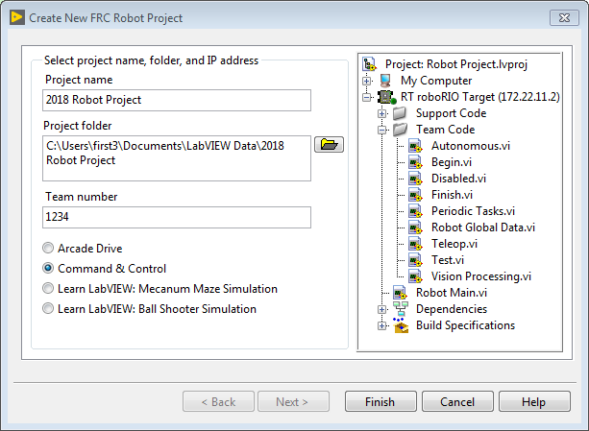
Getting Started
Notes:
When you select ‘Create a New Project’, you’ll want to select the third radio button titled ‘Command & Control’—roboRIO. This will create a new project with the Command and Control folder structure.

Slide 10
Project Explorer

Slide 11
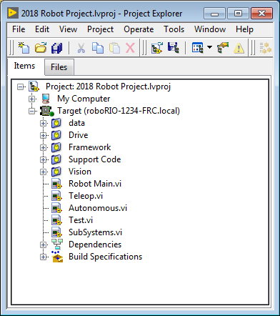
Project Explorer
Added folders for:
Data
Drive
Framework
Support Code
Vision
Added SubSystems.vi
Notes:
The Project Explorer provides organization for all of the Vis and files you will use for your robot system. We’ll go through the major components in the Project Explorer to help with the expansion of our system.
You’ll notice that this project explorer looks a little different than the standard one. We’ve added folders for the Framework, Support Code, data, Drive, and Vision, as well as a SubSystems VI. We’ll dive a bit deeper into each of these folders and what they contain.

Slide 12
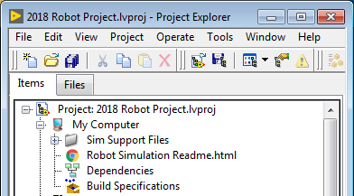
Project Explorer
My Computer
Can be used as simulation target
Populated with simulation files
Sim Support Files
Robot Simulation Readme.html
Build Specifications
For simulation mode
Notes:
My Computer – the items that define operation on the computer that the project was loaded on. For a robot project, this is used as a simulation target and is populated with simulation files.
Sim Support Files — folder containing 3D CAD models and description files for the simulated robot.
Robot Simulation Readme.html — documents the PWM channels and robot info you will need in order to write robot code that matches the wiring of the simulated robot.
Dependencies – shows the files used by the simulated robot’s code. This will populate when you designate the code for the simulated robot target.
Build Specifications – will contain the files that define how to build and deploy code for the simulated robot target.
Target (roboRIO-TEAM-FRC.local) – the items that define operation on the roboRIO located at (address).

Slide 13
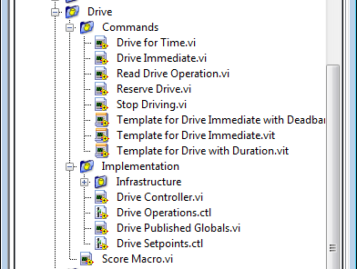
Project Explorer
Drive
Subsystem implementation and commands for the drive base
Each subsystem will have it’s own folder hierarchy
Notes:
Drive — subsystem implementation and commands for the robot drive base. This serves as a custom replacement for the WPILib RobotDrive VIs.

Slide 14
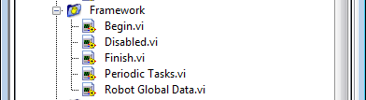
Project Explorer
Framework
Used for VIs that are not part of a subsystem
Not often used
Notes:
Framework — VIs used for robot code that is not part of a subsystem that are not used very often.
Begin — called once when robot code first starts. This is useful for initialization code that doesn’t belong to a particular subsystem.
Disabled — called once for each disabled packet and can be used to debug sensors when you don’t want the robot to move.
Finish — during development, this may be called when robot code finishes. Not called on abort or when power is turned off.
Periodic Tasks — a good place for ad hoc periodic loops for debugging or monitoring
Robot Global Data — useful for sharing robot information that doesn’t belong to a subsystem.

Slide 15
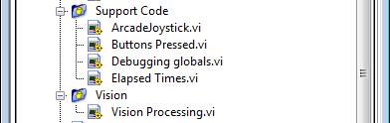
Project Explorer
Support code
Contains debugging and code development aids
Vision subsystem folder
Add custom vision processing here
Notes:
Support Code — debugging and code development aids.
Vision — subsystem and commands for the camera and image processing.

Slide 16
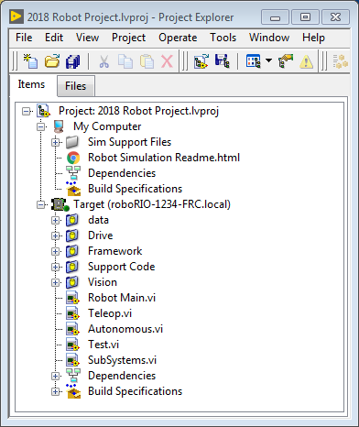
Project Explorer
Main level VIs needed to run the project
Subsystems.vi is unique to Command and Control projects
Notes:
Robot Main.vi — Top level VI that you will run while developing code.
Autonomous.vi — VI that runs during autonomous period.
Teleop.vi — VI that is called for each TeleOp packet.
Test.vi — VI that runs when driver station is in test mode.
SubSystems.vi — VI that contains and starts all subsystems.
Dependencies – shows the files used by the robot code.
Build Specifications — used to build and run the code as a startup application once code works correctly.

Slide 17
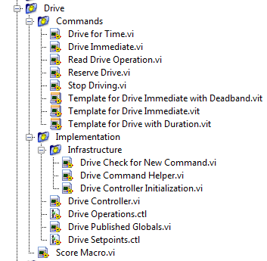
Project Explorer: Drive Subsystem
Drive>>Commands
Command VIs for the Drive subsystem
Notes:
Commands:
This folder contains the command VIs that request the controller carry out an operation. It also contains templates for creating additional drive commands.
Note: After creating a new command, you may need to edit Drive Setpoints.ctl to add or update fields that controller uses to define the new operation. You also need to go into the Drive Controller.vi and modify the case structure to add a case for every value.

Slide 18
Project Explorer: Drive Subsystem
Infrastructure VIs
VIs that support the subsystem functionality
Driver Controller VI
Main control loop for the subsystem
Notes:
Infrastructure VIs
Drive Check for New Command: It is called each iteration of the controller loop. It checks for new commands, updates timing data, and upon completion notifies a waiting command.
Drive Command Helper.vi: Commands call this VI to notify the controller that a new command has been issued.
Drive Controller Initialization.vi: It allocates the notifier and combines the timing, default command, and other information into a single data wire.
Drive Controller.vi: This VI contains the control/state machine loop. The panel may also contain displays useful for debugging.
Drive Operation.ctl: This typedef defines the operational modes of the controller. Many commands can share an operation.
Drive Setpoint.ctl: It contains the data fields used by all operating modes of the Drive subsystem.
Drive Published Globals.vi: A useful place for publishing global information about the drive subsystem.

Slide 19
Initializing the Drive Subsystem

Slide 20
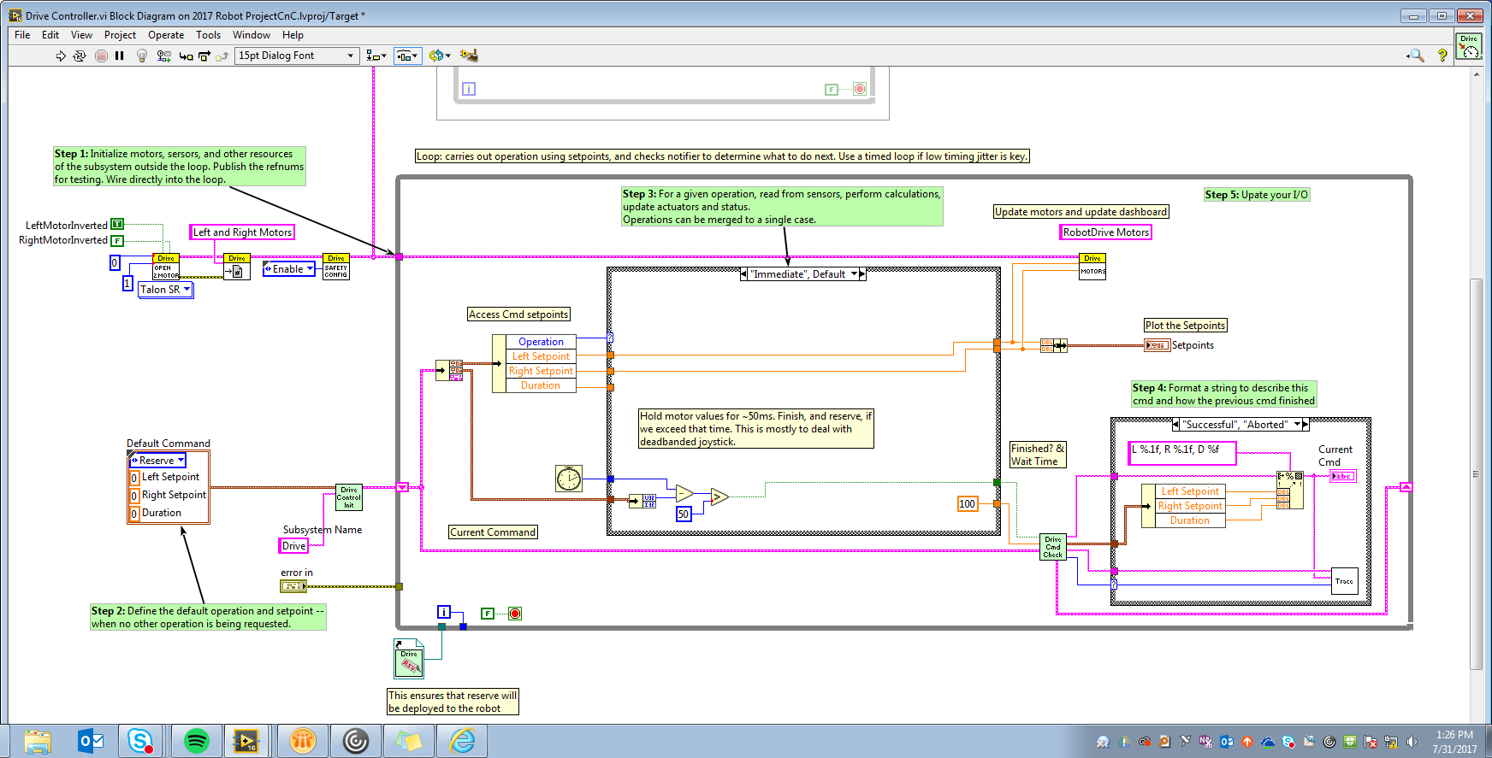
Initializing the Drive Subsystem
Code to the left of the control loop will execute once when the subsystem starts
Notes:
The area to the left of the control loop will execute once when the subsystem starts up. This is where you will typically allocate and initialize all I/O and state data. You may publish the I/O refnums, or you may register them for Test Mode Only to keep them private so that other code cannot update motors without using a command.
There are green comments on the controller’s block diagram that point out key areas that you will want to know how to edit.
Note: Initializing the resources for each subsystem in their respective Controller.vi rather than in Begin.vi improves I/O encapsulation, reducing potential resource conflicts and simplifies debugging.

Slide 21
Initializing the Drive Subsystem
Select the default operation and set default point values
Notes:
Part of the initialization is to select the default operation and set point values when no other operation is being processed.

Slide 22
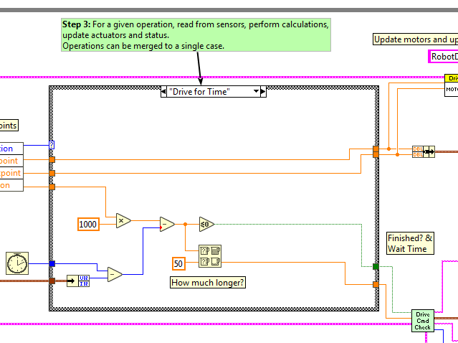
Initializing the Drive Subsystem
Operations are actually implemented within the case statement
Notes:
Inside the control loop is a case statement where operations are actually implemented. Set point values, iteration delay, iteration count, and sensors can all have influence on how the subsystem operates. This case structure has a value for each operation state of the subsystem.

Slide 23
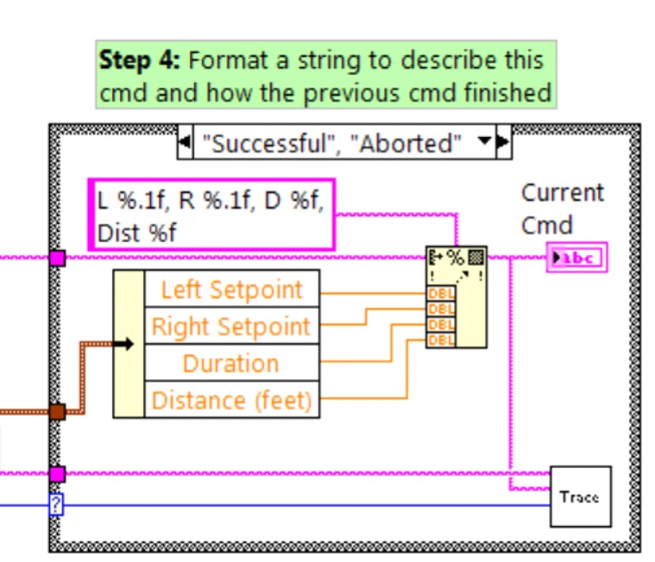
Initializing the Drive Subsystem
Each iteration can optionally update the Trace VI
Helpful to update to trace any errors or issues
Notes:
Each iteration of the controller loop will optionally update the Trace VI. The framework already incorporates the subsystem name, operation, and description, and you may find it helpful to format additional set point values into the trace information. Open the Trace VI and click Enable while the robot code is running to current setpoints and commands sent to each subsystem.

Slide 24
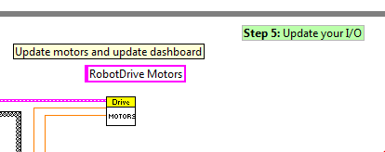
Initializing the Drive Subsystem
Primary goal is to update the actuators for the subsystem
Ensure that the values are only updated in one location in the code
Notes:
The primary goal of the controller is to update actuators for the subsystem. This can occur within the case structure, but many times, it is beneficial to do it downstream of the structure to ensure that values are always updated with the correct value and in only one location in the code.

Slide 25
Drive Subsystem Shipped Commands

Slide 26

Drive Subsystem Shipped Commands
Drive For Time.vi
Sets the motors to run for a given number of seconds
Optionally synchronizes with the completion of the command

Slide 27
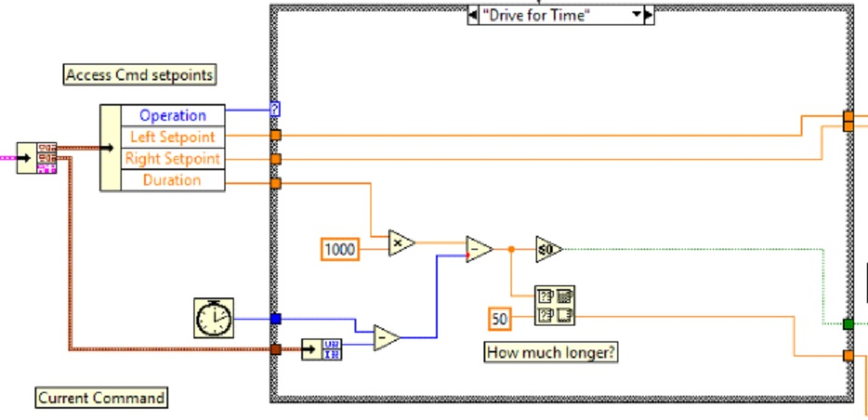
Drive Subsystem Shipped Commands
Drive For Time.vi
Notes:
The Drive for Time case will operate the motors at the set point until the timer elapses or a new command is issued. If the motors have the safety timeout enabled, it is necessary to update the motors at least once every 100ms. This is why the code waits for the smaller of the remaining time and 50ms.

Slide 28

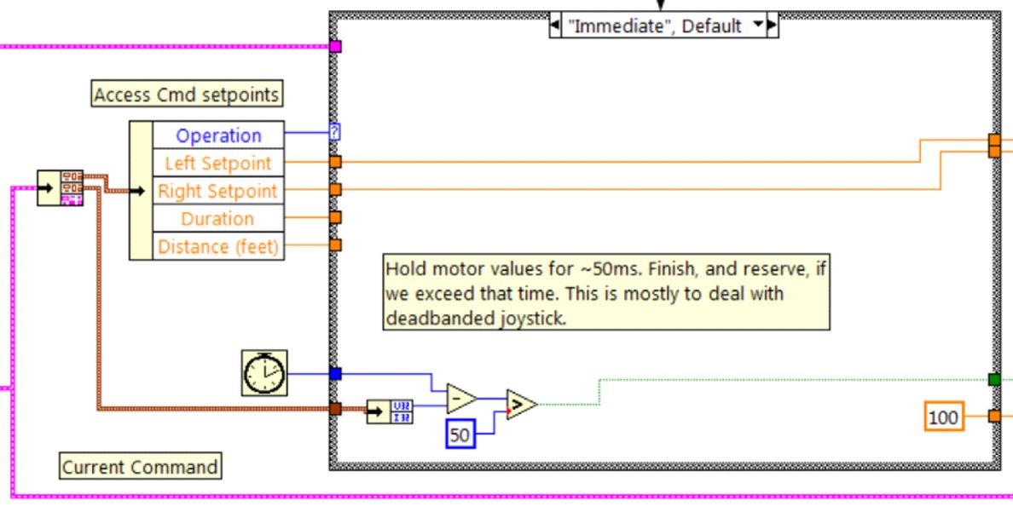
Drive Subsystem Shipped Commands
Drive Immediate.vi
Sets motors immediately to the desired speeds
Notes:
Gets the desired left and right speeds for the motors and will set the motors immediately to those set points.
The Immediate case updates the motors to the set point defined by the command. The command is not considered finished since you want the motors to maintain this value until a new command comes in or until a timeout value. The timeout is useful anytime a command includes a dead band. Small values will not be requested if smaller than the dead band, and will result in growling or creeping unless the command times out.

Slide 29

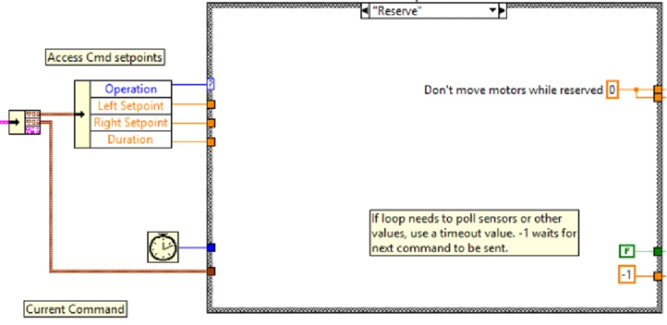
Drive Subsystem Shipped Commands
Stop Driving.vi
Immediately sets the speed of the motors to zero
Notes:
Zero the drive motors, making the robot stationary.
The Reserve command turns off the motors and waits for a new command. When used with a named command sequence, reserve identifies that the drive subsystem is part of a sequence, even if not currently moving the robot. This helps to arbitrate subsystem resource between simultaneously running commands.

Slide 30
Creating New Commands

Slide 31
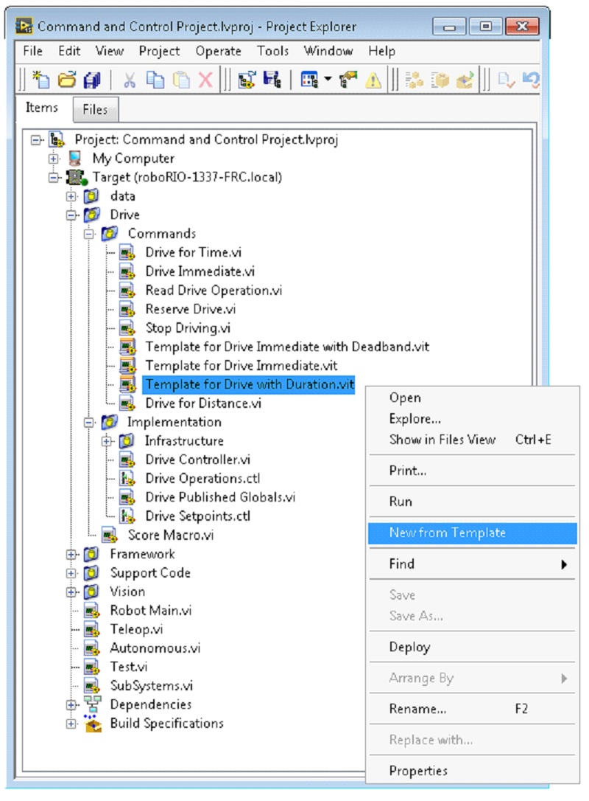
Creating New Commands
Open the subsystem Commands folder
Choose one of the VI templates to use as a starting point
Right-click >> New From Template
Notes:
The Command and Control framework allows users to easily create new commands for a subsystem. To Create a new command open the subsystem folder/Commands In the project explorer window, choose one of the VI Templates to use as the starting point of your new command, right click, and select New From Template.

Slide 32
Creating New Commands
Three kinds of timing:
Immediate: notifies the subsystem about the new setpoint immediately
Immediate with deadband: compares the new value to the deadband value and optionally notifies the subsystem
With duration: notifies the subsystem to perform this command for a specified duration then return to the default state
Notes:
There are three kinds of timing associated with the templates.
Immediate: This VI notifies the subsystem about the new setpoint.
Immediate with deadband: This VI compares the input value to the deadband and optionally notifies the subsystem about the new setpoint. This is very useful when joystick continuous values are being used.
With duration: This VI notifies the subsystem to perform this command for the given duration, and then return to the default state. Synchronization determines whether this VI Starts the operation and returns immediately, or waits for the operation to complete. The first option is commonly used for TeleOp, and the second for Autonomous sequencing.

Slide 33
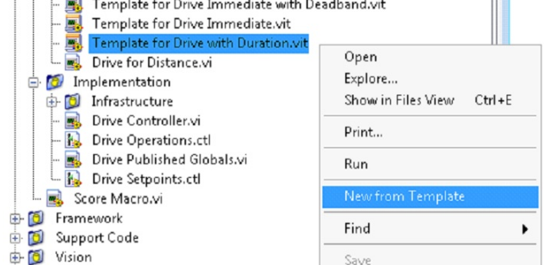
Creating New Commands—Example
Adding the command “Drive for Distance”
Notes:
We’re going to go through an example of adding the command ‘Drive for Distance.’ First, we’ll create a new VI from the Drive with Duration template. Save the new VI with a descriptive name such as “Drive for Distance”.

Slide 34
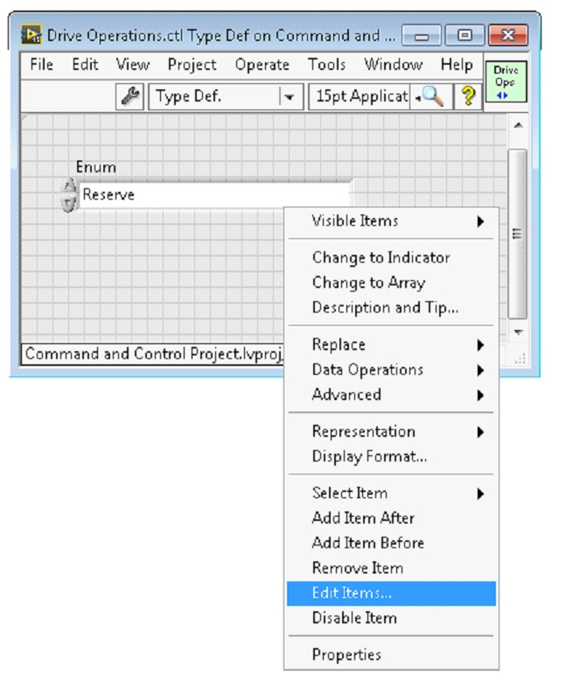
Creating New Commands—Example
Add the new command to the Drive Operations enum typdef
Notes:
Next, determine whether the new command needs a new value added the Drive Operations enum typedef. The initial project code already has an enum value of Drive for Distance, but the following image shows how you would add one if needed.

Slide 35
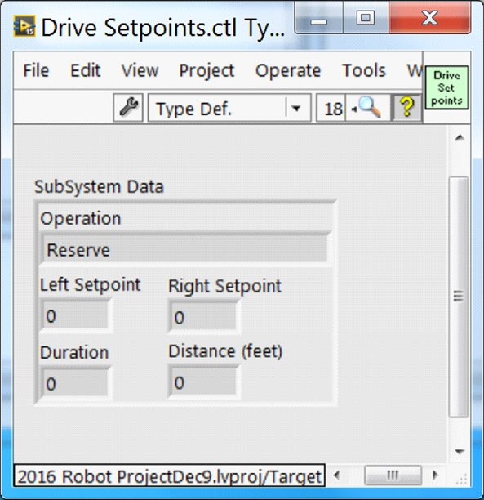
Creating New Commands—Example
Add any additional information needed to the setpoint control
Notes:
If a command needs additional information to execute, add it to the setpoints control. By default, the Drive subsystem has fields for the Left Setpoint, Right Setpoint, and Duration along with the operation to be executed. The Drive for Distance command could reuse Duration as distance, but let’s go ahead and add a numeric control to the Drive Setpoints.ctl called Distance (feet).

Slide 36
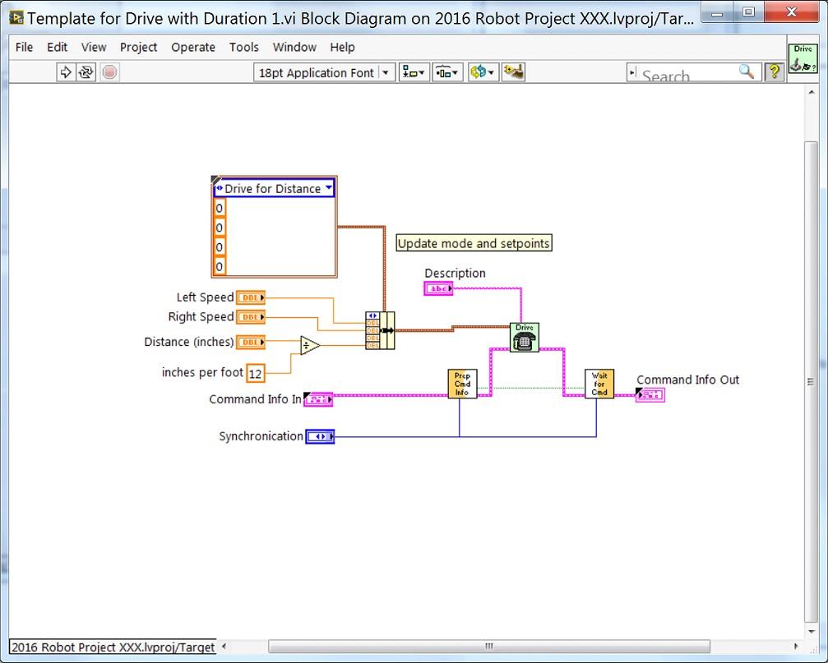
Creating New Commands
Notes:
Once that we have all of the fields needed to specify our command, we can modify the newly created Drive for Distance.vi. As shown below, select Drive for Distance from the enum’s drop down menu and add a VI parameters to specify distance, speeds, etc. If the units do not match, the command VI is a great place to map between units.

Slide 37
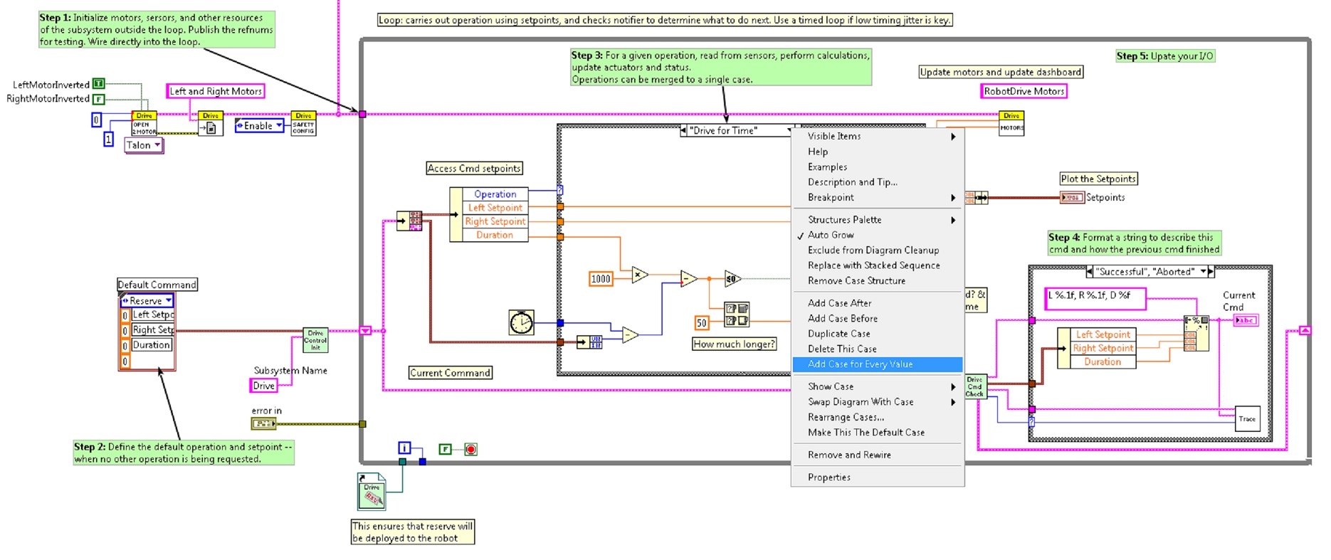
Creating New Commands
Add code to the Drive Controller to define what happens when the Drive for Distance command executes
Notes:
Next, add code to the Drive Controller to define what happens when the Drive for Distance command executes. Right click on the Case Structure and Duplicate or Add Case for Every Value. This will create a new “Drive for Distance” case.

Slide 38
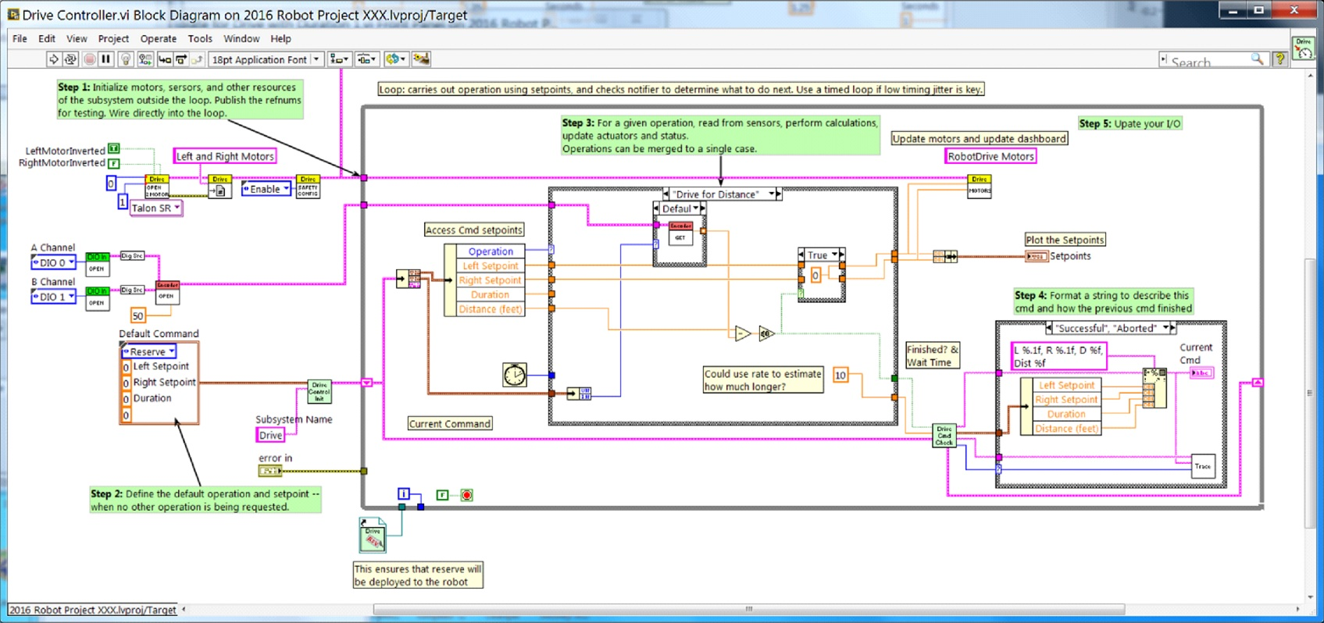
Creating New Commands
Notes:
In order to access new setpoint fields, grow the “Access Cmd setpoints” unbundle node. Open your encoder(s) on the outside, to the left of the loop. In the new diagram of the case structure, we added a call to reset the encoder on the first loop iteration and read it otherwise. There is also some simple code that compares encoder values and updates the motor power. If new controls are added to the setpoints cluster, you should also consider adding them to the Trace. The necessary changes are shown in the image below.

Slide 39
Creating a Subsystem

Slide 40
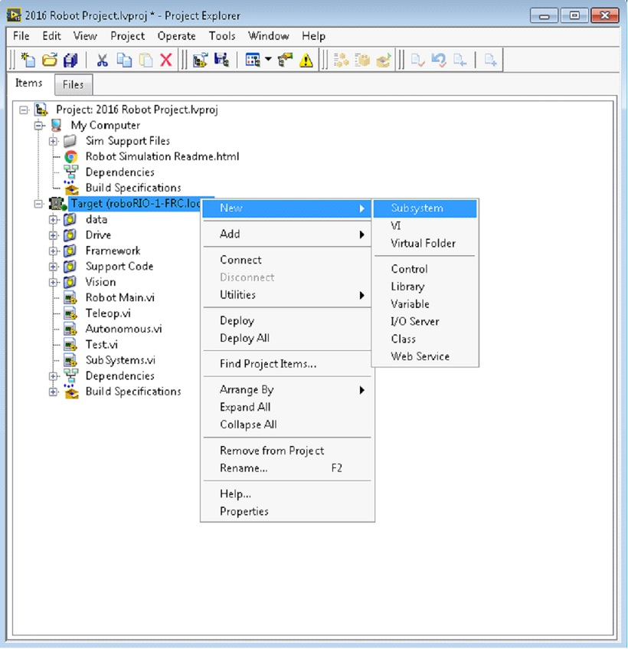
Creating a Subsystem
Right-click on the roboRIO target
Select New>>Subsystem
Notes:
In order to create a new subsystem, right click on the roboRIO target and select New» Subsystem. In the pop up dialog box, enter the name of the subsystem, list the operational modes, and specify the color of the icon.

Slide 41
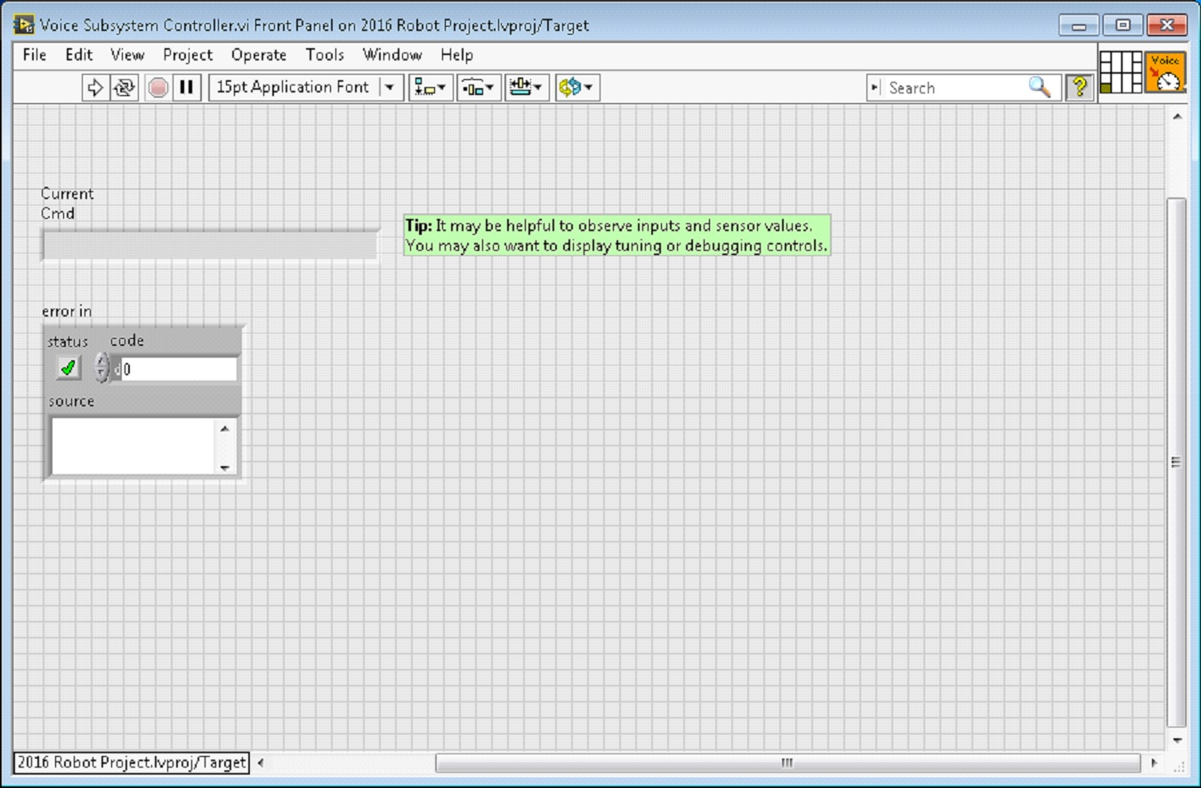
Creating a Subsystem
Controller VI will automatically open
Notes:
When you click OK, the subsystem folder will be generated and added to the project disk folder and tree. It will contain a base implementation of the VIs and controls that make up a subsystem. A call to the new controller will be inserted into the Subsystems VI. The controller VI will open, ready for you to add I/O and implement state machine or control code. Generated VI icons will use the color and name provided in the dialog. The generated code will use typedefs for set point fields and operations.

Slide 42
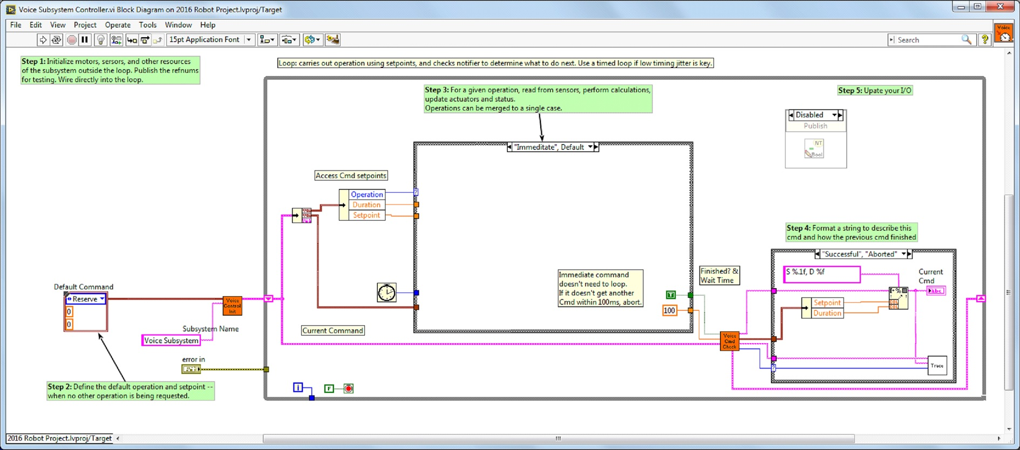
Creating a Subsystem
Framework code is automatically generated
Notes:
Below is the block diagram of the newly created subsystem. This code will be generated automatically when you create the subsystem.

Slide 43
Demonstration
Creating a new subsystem
Adding a new command

Slide 44
Further Resources
Command and Control Tutorial
https://decibel.ni.com/content/docs/DOC-46544
How to use the new Control and Command framework for FRC
https://decibel.ni.com/content/docs/DOC-44963

